Slide 1
Causal Inference Crash Course Part 2: Defining Some Causal Models
Julian Hsu

Slide 2
Causal Inference Series
Foundations
Defining Some ATE/ATET Causal Models
ATE/ATET Inference, Asymptotic Theory, and Bootstrapping
Best Practices: Outliers, Class Imbalance, Feature Selection, and Bad Control
Heterogeneous Treatment Effect Models and Inference
Difference-in-Difference Models for Panel Data
Regression Discontinuity Models
Arguable Validation

Slide 3
Overview
This presentation will define some propensity-matching based models:
Ordinary Least Squares (OLS)
Propensity Binning with Regression adjustment
Inverse propensity weighting
Double machine learning - Partial Linear Model (PLM)
Double machine learning - Interactive Regression Model (IRM)
For each model, we will define the estimator and its properties.
So yes, there will be a lot of math.

Slide 4
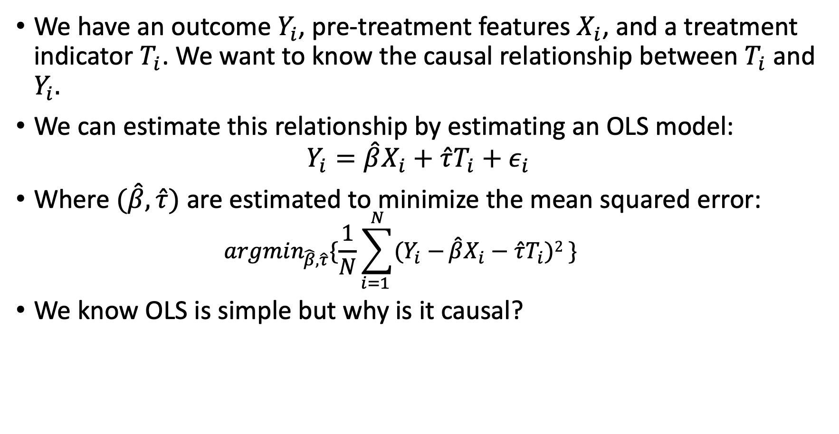
Ordinary Least Squares (OLS)
We have an outcome $Y_{i}$, pre-treatment features $X_{i}$, and a treatment indicator $T_{i}$. We want to know the causal relationship between $T_{i}$ and $Y_{i}.$
We can estimate this relationship by estimating an OLS model:
$$Y_{i}=\hat{β}X_{i}+\hat{τ}T_{i}+ε_{i}$$
Where $(\hat{β}, \hat{τ})$ are estimated to minimize the mean squared error:
$$argmin_{\hat{β}, \hat{τ}}\{\frac{1}{N}\sum_{i=1 }^{N}{(Y_{i}−}\hat{β}X_{i}−\hat{τ}T_{i})2 \}$$
We know OLS is simple but why is it causal?

Slide 5
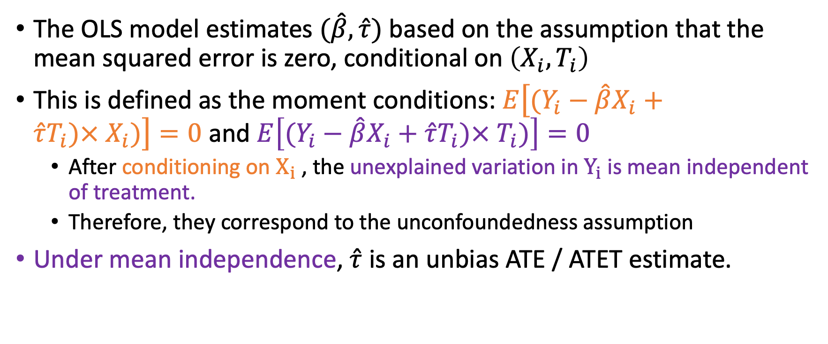
Why is OLS Causal?
The OLS model estimates $(\hat{β}, \hat{τ})$ based on the assumption that the mean squared error is zero, conditional on $\left(X_{i}, T_{i}\right)$
This is defined as the moment conditions: $E\left[(Y_{i}−\hat{β}X_{i}+\hat{τ}T_{i}){× X}_{i})\right]=0$ and $E\left[(Y_{i}−\hat{β}X_{i}+\hat{τ}T_{i})×{ T}_{i})\right]=0$
After conditioning on $X_{i}$ , the unexplained variation in $Y_{i}$ is mean independent of treatment.
Therefore, they correspond to the unconfoundedness assumption
Under mean independence, $\hat{τ}$ is an unbias ATE / ATET estimate.
Notes:
That that the OLS model will force these moments to be zero, but whether it has the correct estimates is a different story. That is where the unconfoundedness assumption comes in.

Slide 6
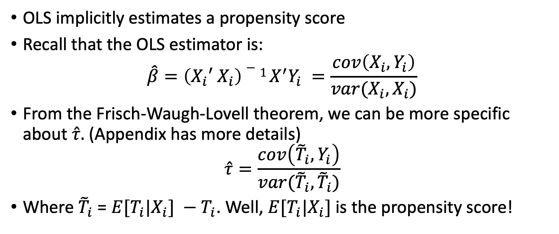
OLS as a propensity-based matching model
OLS implicitly estimates a propensity score
Recall that the OLS estimator is:
$$\hat{β}=\left(X_{i}{′ X}_{i}\right)−1 X^{′}Y_{i} =\frac{cov\left(X_{i}, Y_{i}\right)}{var(X_{i}, X_{i})}$$
From the Frisch-Waugh-Lovell theorem, we can be more specific about $\hat{τ}.$ (Appendix has more details)
$$\hat{τ}=\frac{cov\left({\tilde{T}}_{i}, Y_{i}\right)}{var({\tilde{T}}_{i},{\tilde{T}}_{i})}$$
Where ${\tilde{T}}_{i}$ = ${E[T}_{i}|X_{i}] −T_{i}$. Well, ${E[T}_{i}|X_{i}]$is the propensity score!

Slide 7
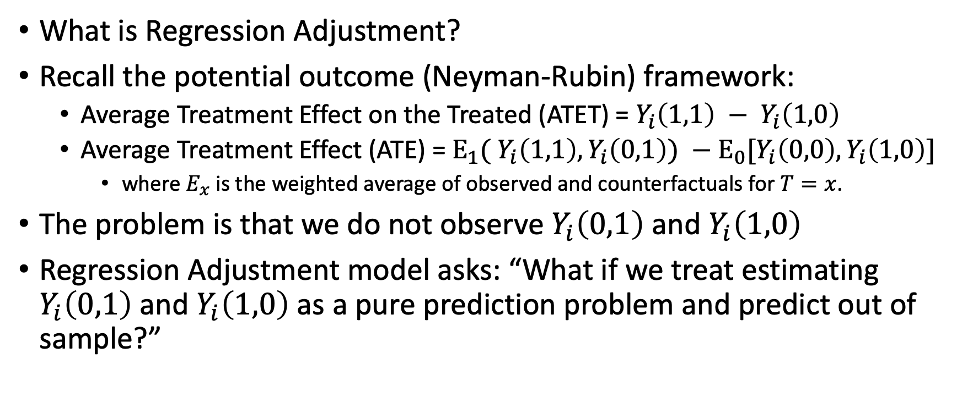
Propensity Binning with Regression Adjustment
What is Regression Adjustment?
Recall the potential outcome (Neyman-Rubin) framework:
Average Treatment Effect on the Treated (ATET) = $Y_{i}\left(1,1\right) − Y_{i}\left(1,0\right)$
Average Treatment Effect (ATE) = $E_{1}( Y_{i}\left(1,1\right), Y_{i}\left(0,1\right)) −E_{0}[Y_{i}\left(0,0\right), Y_{i}\left(1,0\right)]$
where $E_{x}$ is the weighted average of observed and counterfactuals for $T=x$.
The problem is that we do not observe $Y_{i}\left(0,1\right)$ and $Y_{i}\left(1,0\right)$
Regression Adjustment model asks: “What if we treat estimating $Y_{i}\left(0,1\right)$ and $Y_{i}\left(1,0\right)$ as a pure prediction problem and predict out of sample?”
Notes:
$Y_{i}\left(0,1\right)$ is the outcome of the control group if they were treated.
$Y_{i}\left(1,0\right)$ is the outcome of the treatment group if they were in control.

Slide 8
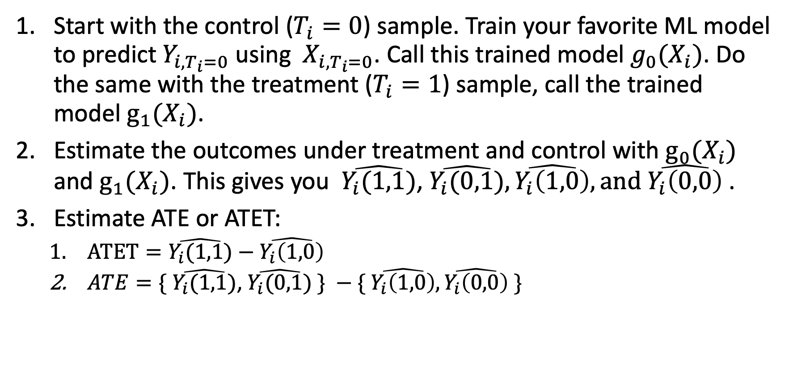
Regression Adjustment Algorithm
Start with the control ($T_{i}=0$) sample. Train your favorite ML model to predict $Y_{i,T_{i}=0}$ using ${ X}_{i,T_{i}=0}$. Call this trained model $g_{0}(X_{i})$. Do the same with the treatment ($T_{i}=1$) sample, call the trained model $g_{1}(X_{i})$.
Estimate the outcomes under treatment and control with $g_{0}(X_{i})$ and $g_{1}(X_{i})$. This gives you $\hat{Y_{i}(1,1)}$, $\hat{Y_{i}(0,1)},\hat{Y_{i}\left(1,0\right)},\text{and} \hat{Y_{i}\left(0,0\right)}$.
Estimate ATE or ATET:
$ATET=\hat{Y_{i}(1,1)}−\hat{Y_{i}\left(1,0\right)}$
$ATE=\{ \hat{Y_{i}(1,1)}$, $\hat{Y_{i}(0,1)} \} −\{ \hat{Y_{i}\left(1,0\right)},\hat{Y_{i}\left(0,0\right)} \}$
Notes:
We also do the prediction for the observed states for additional precision.

Slide 9
Regression Adjustment is OLS
Regression Adjustment is OLS in disguise.
Intuitively, this is because the OLS is also extrapolating the potential outcomes with a single model, instead of multiple. (Appendix has the technical explanation.)
Therefore, Regression Adjustment implicitly estimates a propensity score because OLS does too.

Slide 10




Propensity Binning as Insurance Against Outliers
Outcome $Y_{i}$
Treatment $(T_{i}=1)$
We show in the dotted lines the predicted outcomes for control and treatment.
But we have outliers , based on propensity score, which are influencing our predicted outcomes.
How can we flexibly accommodate the outliers?
Control $(T_{i}=0)$
Propensity Score ${\hat{P}}_{i}(X_{i})$

Slide 11

Propensity Binning with Regression Adjustment
We estimate a propensity score, ${\hat{P}}_{i}(X_{i})$, and then divide the data into segments of ${\hat{P}}_{i}\left(X_{i}\right).$
For each segment, implement the Regression Adjustment model.

Slide 12
Inverse Propensity Weighting
This approach is inspired by sampling methods.
Suppose you have :
(A) treatment observation with a propensity score of 0.99
(B) treatment observation with a propensity score of 0.01
You most likely have a lot of (A), but not a lot of (B). So you want to give (B) more weight in your analysis because it happens very rarely.

Slide 13
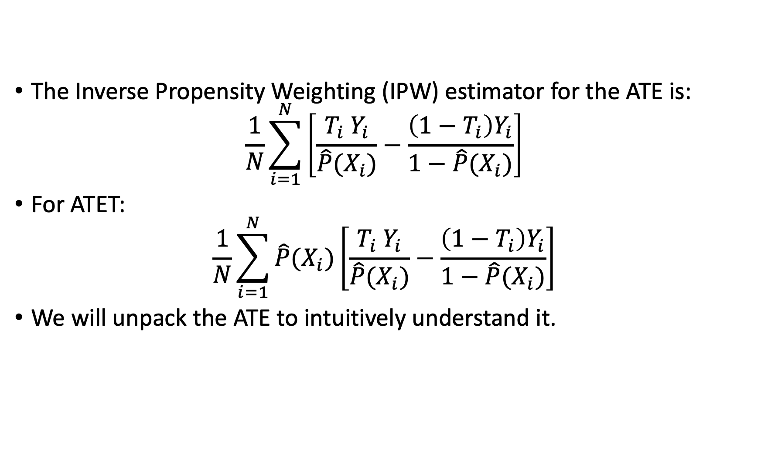
Inverse Propensity Weighting Model Definition
The Inverse Propensity Weighting (IPW) estimator for the ATE is:
$$\frac{1}{N}\sum_{i=1}^{N}{\left[\frac{T_{i} Y_{i}}{\hat{P}(X_{i})}−\frac{\left(1−T_{i}\right)Y_{i}}{1−\hat{P}(X_{i})}\right]}$$
For ATET:
$$\frac{1}{N}\sum_{i=1}^{N}{\hat{P}(X_{i})\left[\frac{T_{i} Y_{i}}{\hat{P}(X_{i})}−\frac{\left(1−T_{i}\right)Y_{i}}{1−\hat{P}(X_{i})}\right]}$$
We will unpack the ATE to intuitively understand it.

Slide 14
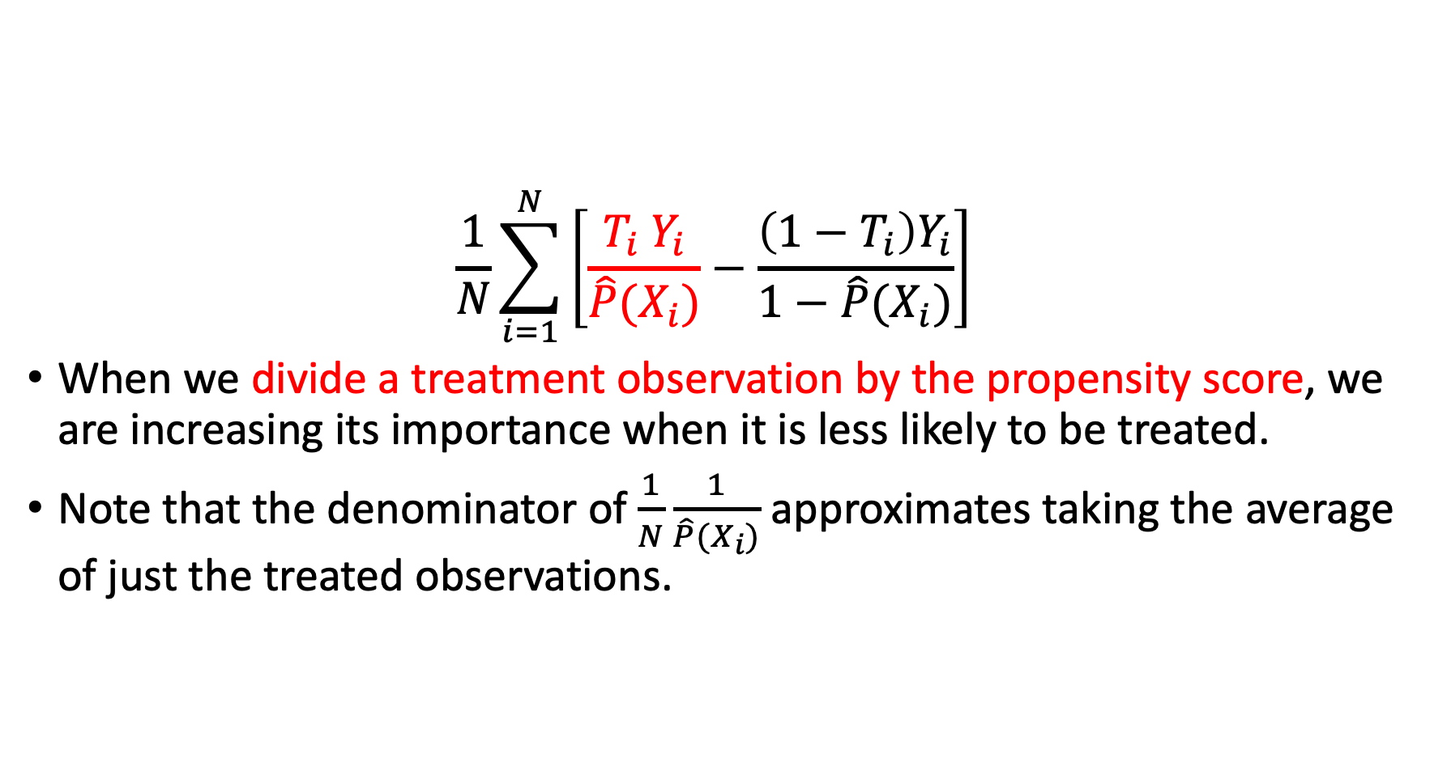
Inverse Propensity Weighting Intuition
$$\frac{1}{N}\sum_{i=1}^{N}{\left[\frac{T_{i} Y_{i}}{\hat{P}(X_{i})}−\frac{\left(1−T_{i}\right)Y_{i}}{1−\hat{P}(X_{i})}\right]}$$
When we divide a treatment observation by the propensity score, we are increasing its importance when it is less likely to be treated.
Note that the denominator of $\frac{1}{N}\frac{1}{\hat{P}(X_{i})}$ approximates taking the average of just the treated observations.
Notes:
This connects to our intuitive explanation because if you divide by 0.01, that observation carries more weight than an observation that you divide by 0.99. Similar logic for control – if you have a control observation with a propensity score of 0.99, it should carry more weight than a control observation with a propensity score of 0.01.

Slide 15
Advantages and Disadvantages
Advantages: Weighting provides flexible form and only requires diagnosing with propensity score
Disadvantage: since we divide by the propensity score, you risk imprecise estimates if you have a lot of propensity scores near zero or one.
This means the variance can explode and be very large.
Solutions are:
Drop these observations;
Replace these observations’ propensity scores with a pre-determined value (like 0.001 or 0.999) or unconditional probability of treatment.

Slide 16
Double Machine Learning (DML)
Yes, we are finally here.
At a high-level, DML is a more flexible version of the previous models
Note that DML relies on the same assumptions as the other models presented here
We will cover the propensity-matching based models from the Chernozhukov et al. (2016) paper.
Partial Linear Model
Interactive Regression Model
Notes:
Note that more flexible doesn’t necessarily mean superior performance. Unlike other models, DML has more hyperparameters because it has more components, which we will see.

Slide 17
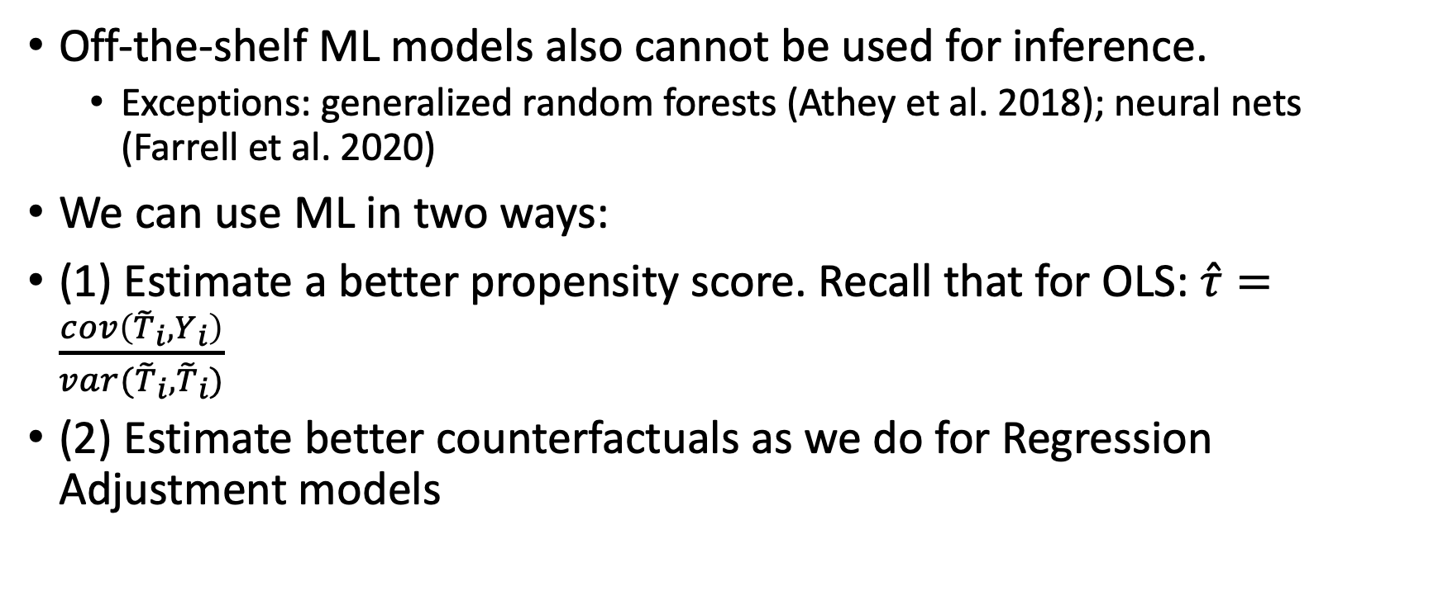
What can ML do for causal inference?
Off-the-shelf ML models also cannot be used for inference.
Exceptions: generalized random forests (Athey et al. 2018); neural nets (Farrell et al. 2020)
We can use ML in two ways:
(1) Estimate a better propensity score. Recall that for OLS: $\hat{τ}=\frac{cov\left({\tilde{T}}_{i}, Y_{i}\right)}{var({\tilde{T}}_{i},{\tilde{T}}_{i})}$
(2) Estimate better counterfactuals as we do for Regression Adjustment models
Notes:
ML models trade off decreased variance for increased bias, so we cannot use it for causal inference.

Slide 18
High-Level Strategy for DML
We use two ML strategies so we can do inference:
(1) Regularization based on residualization
Based on Frisch-Waugh-Lovell theorem (recall this from the OLS slides?)
Compare residuals that are constructed to be independent except due to the variation of interest (Neyman orthogonality)
(2) Sample-splitting to prevent overfitting
Cross-validation is important to make sure prediction is not biased
Notes:
We will use ML to isolate the variation in the outcome and treatment that are arguably exogeneous.
We maximize ML’s prediction power to explain the outcome and treatment based on pre-treatment features. Based on the unconfoundedned assumption, we assume the unexplained variation is only explained by the treatment status.

Slide 19
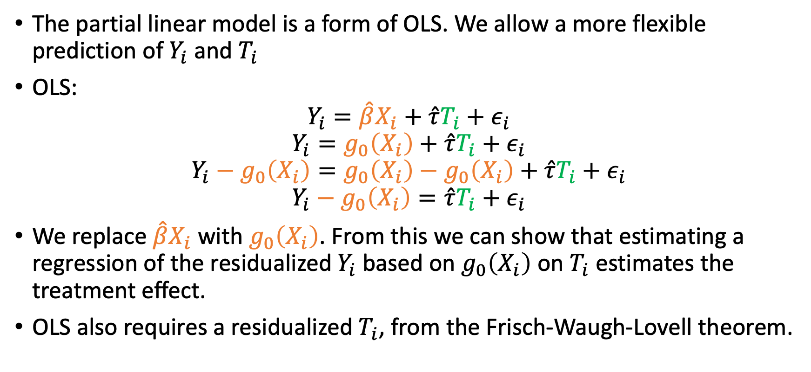
DML – Partial Linear Model Motivation
The partial linear model is a form of OLS. We allow a more flexible prediction of $Y_{i}$ and $T_{i}$
OLS:
$$Y_{i}=\hat{β}X_{i}+\hat{τ}T_{i}+ε_{i}$$
$$Y_{i}=g_{0}\left(X_{i}\right)+\hat{τ}T_{i}+ε_{i}$$
$$Y_{i}−g_{0}\left(X_{i}\right)=g_{0}\left(X_{i}\right)−g_{0}\left(X_{i}\right)+\hat{τ}T_{i}+ε_{i}$$
$$Y_{i}−g_{0}\left(X_{i}\right)=\hat{τ}T_{i}+ε_{i}$$
We replace $\hat{β}X_{i}$ with $g_{0}\left(X_{i}\right)$. From this we can show that estimating a regression of the residualized $Y_{i}$ based on $g_{0}\left(X_{i}\right)$ on $T_{i}$ estimates the treatment effect.
OLS also requires a residualized $T_{i}$, from the Frisch-Waugh-Lovell theorem.
Notes:
The orange part in OLS plays two roles. (1) it implicitly estimates the propensity score, and (2) sort of residualizes Y. It does this all with one model, which is very restrictive.
DML separates these two roles into separate ML models that predict the propensity score and predict Y.

Slide 20
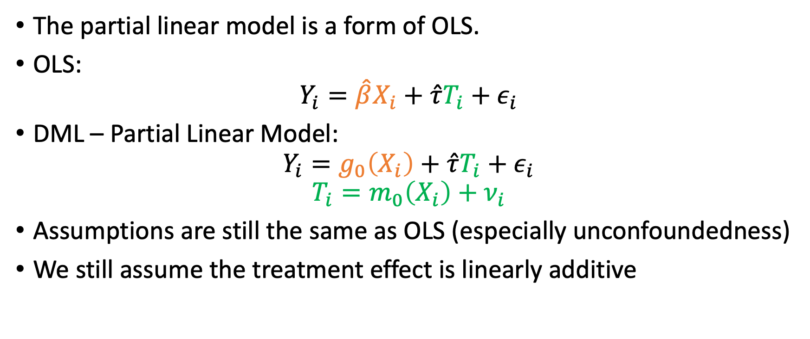
DML – Partial Linear Model Setup
The partial linear model is a form of OLS.
OLS:
$$Y_{i}=\hat{β}X_{i}+\hat{τ}T_{i}+ε_{i}$$
DML – Partial Linear Model:
$$Y_{i}=g_{0}\left(X_{i}\right)+\hat{τ}T_{i}+ε_{i}$$
$$T_{i}=m_{0}\left(X_{i}\right)+ν_{i}$$
Assumptions are still the same as OLS (especially unconfoundedness)
We still assume the treatment effect is linearly additive
Notes:
The orange part in OLS plays two roles. (1) it implicitly estimates the propensity score, and (2) sort of residualizes Y. It does this all with one model, which is very restrictive.
DML separates these two roles into separate ML models that predict the propensity score and predict Y.

Slide 21

Partial Linear Model Procedure
$$Y_{i}=g_{0}\left(X_{i}\right)+\hat{τ}T_{i}+ε_{i}$$
$$T_{i}=m_{0}\left(X_{i}\right)+ν_{i}$$
First Stage:
Predict $Y_{i}$ using $X_{i}$ with sample-splitting, get ${\hat{Y}}_{i}$
Predict${ T}_{i}$using $X_{i}$ with sample-splitting , get ${\hat{T}}_{i}$
Calculate the residuals for $Y_{i}$ and $T_{i}.$
Specifically, ${\tilde{Y}}_{i}$ = $Y_{i}−{\hat{Y}}_{i}$ and ${\tilde{T}}_{i}$ = $T_{i}−{\hat{T}}_{i}$
Second Stage:
Estimate this OLS model:
$${\tilde{Y}}_{i}=\hat{τ}{\tilde{T}}_{i}+ζ_{i}$$
Sample-splitting
Residualization
Notes:
1. Note that if you used OLS to predict Y and T, you should get an answer very similar to running OLS. It won’t be exactly the same due to sample-splitting and that you are using different models.
2. There is also the idea of cross-fitting, which is that you do the entire First Stage on one half, and the Second Stage on the second half. Then you do vice versa with the other half, leaving you with two Second Stage estimates that need to be averaged.

Slide 22

What ML models can be used?
You can use essentially any ML model for the first stage to generate ${\hat{Y}}_{i}$ and ${\hat{T}}_{i}$
These are called the “nuisance parameters” because we care about the quality of the prediction, not the theoretical properties of the ML model.
Notes:
Note that the ML model must be n^{1/4} consistent, because each modeling error will then be n^{1/2} consistent. Then the two modeling errors’ product is n^{-1} consistent.

Slide 23
DML – Interactive Regression Model
The partial linear model is simple and intuitive because it is a more flexible version of OLS.
Despite this, we are restricted by the assumption that treatment linearly interacts with the outcome.
It also assumes that the treatment effect is the same for all observations. Specifically, that the average treatment effect (ATE) is the same as the average treatment effect on the treated (ATET).

Slide 24
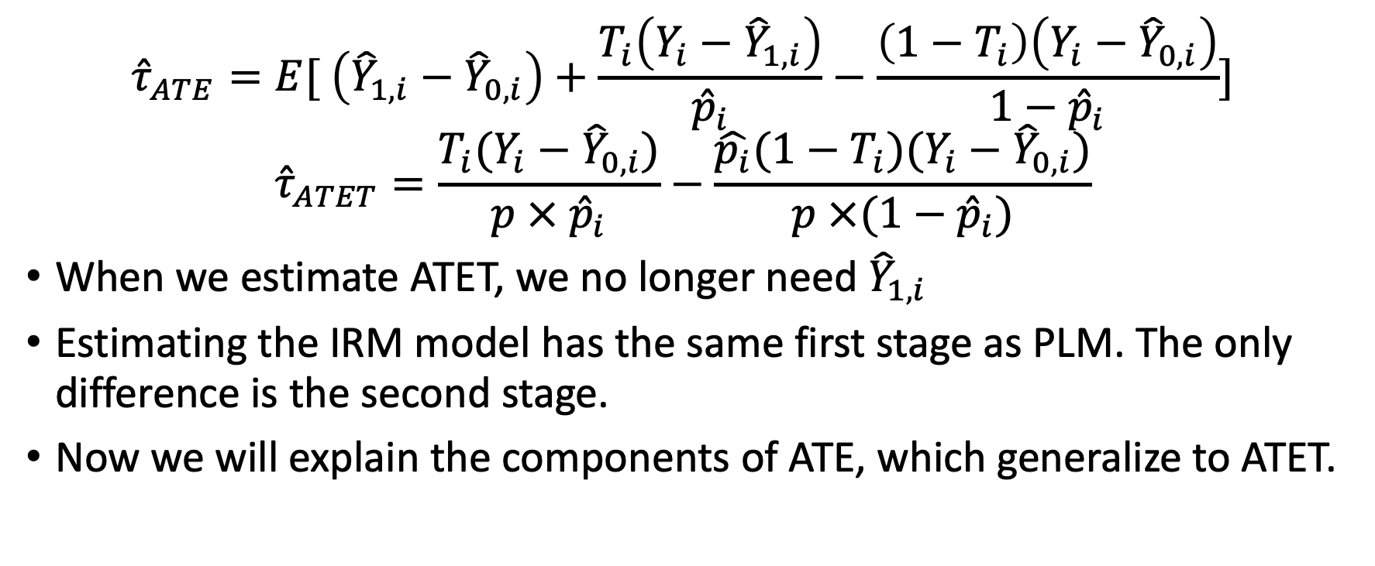
Interactive Regression Model (IRM) Specification
$${\hat{τ}}_{ATE}=E[ \left({\hat{Y}}_{1,i}−{\hat{Y}}_{0,i}\right)+\frac{T_{i}\left(Y_{i}−{\hat{Y}}_{1,i}\right)}{{\hat{p}}_{i}}−\frac{\left(1−T_{i}\right)\left(Y_{i}−{\hat{Y}}_{0,i}\right)}{1−{\hat{p}}_{i}}]$$
$${\hat{τ}}_{ATET}=\frac{T_{i}(Y_{i}−{\hat{Y}}_{0,i})}{p × {\hat{p}}_{i}}−\frac{\hat{p_{i}}(1−T_{i})(Y_{i}−{\hat{Y}}_{0,i})}{p ×(1−{\hat{p}}_{i})}$$
When we estimate ATET, we no longer need ${\hat{Y}}_{1,i}$
Estimating the IRM model has the same first stage as PLM. The only difference is the second stage.
Now we will explain the components of ATE, which generalize to ATET.

Slide 25
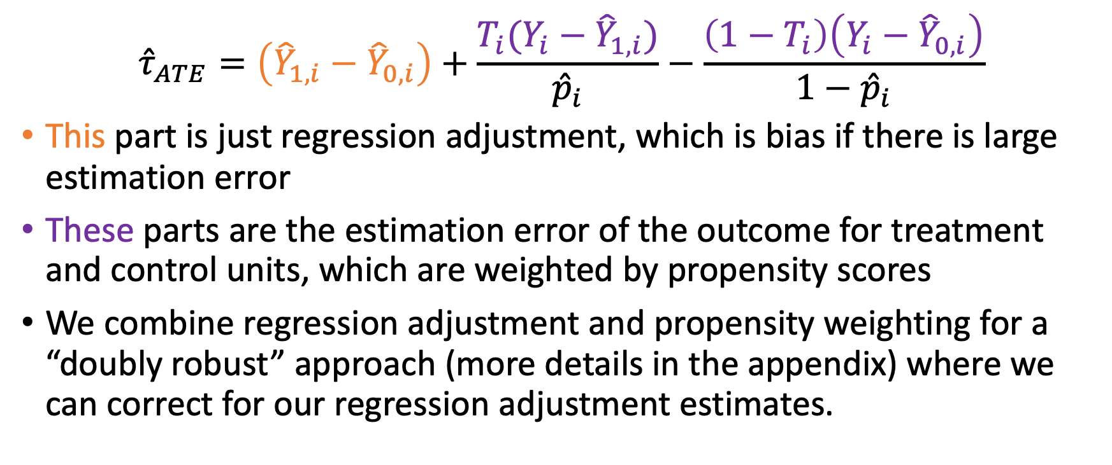
Explaining the IRM Model, Part 1
$${\hat{τ}}_{ATE}=\left({\hat{Y}}_{1,i}−{\hat{Y}}_{0,i}\right)+\frac{T_{i}(Y_{i}−{\hat{Y}}_{1,i})}{{\hat{p}}_{i}}−\frac{\left(1−T_{i}\right)\left(Y_{i}−{\hat{Y}}_{0,i}\right)}{1−{\hat{p}}_{i}}$$
This part is just regression adjustment, which is bias if there is large estimation error
These parts are the estimation error of the outcome for treatment and control units, which are weighted by propensity scores
We combine regression adjustment and propensity weighting for a “doubly robust” approach (more details in the appendix) where we can correct for our regression adjustment estimates.

Slide 26
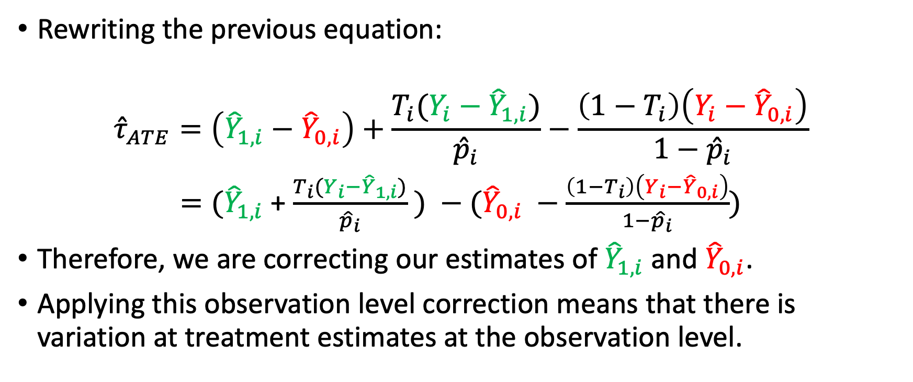
Explaining the IRM Model, Part 2
Rewriting the previous equation:
$${\hat{τ}}_{ATE}=\left({\hat{Y}}_{1,i}−{\hat{Y}}_{0,i}\right)+\frac{T_{i}(Y_{i}−{\hat{Y}}_{1,i})}{{\hat{p}}_{i}}−\frac{\left(1−T_{i}\right)\left(Y_{i}−{\hat{Y}}_{0,i}\right)}{1−{\hat{p}}_{i}}$$
$=({\hat{Y}}_{1,i}$ + $\frac{T_{i}(Y_{i}−{\hat{Y}}_{1,i})}{{\hat{p}}_{i}} ) −({\hat{Y}}_{0,i} −\frac{\left(1−T_{i}\right)\left(Y_{i}−{\hat{Y}}_{0,i}\right)}{1−{\hat{p}}_{i}})$
Therefore, we are correcting our estimates of ${\hat{Y}}_{1,i}$ and ${\hat{Y}}_{0,i}$.
Applying this observation level correction means that there is variation at treatment estimates at the observation level.

Slide 27
Conclusion
This presentation defines some propensity-matching based models:
Ordinary Least Squares (OLS)
Propensity Binning with Regression adjustment
Inverse propensity weighting
Double machine learning - Partial Linear Model (PLM)
Double machine learning - Interactive Regression Model (IRM)
Remember they all rely on the same assumptions!

Slide 28
Causal Inference Series
Foundations
Defining Some Causal Models
Inference, Asymptotic Theory, and Bootstrapping
Heterogeneous Treatment Effect Models
Best Practices: Outliers, Class Imbalance, Feature Selection, and Bad Control
Difference-in-Difference Models for Panel Data
Regression Discontinuity Models
Arguable Validation

Slide 29
Appendix Slides

Slide 30
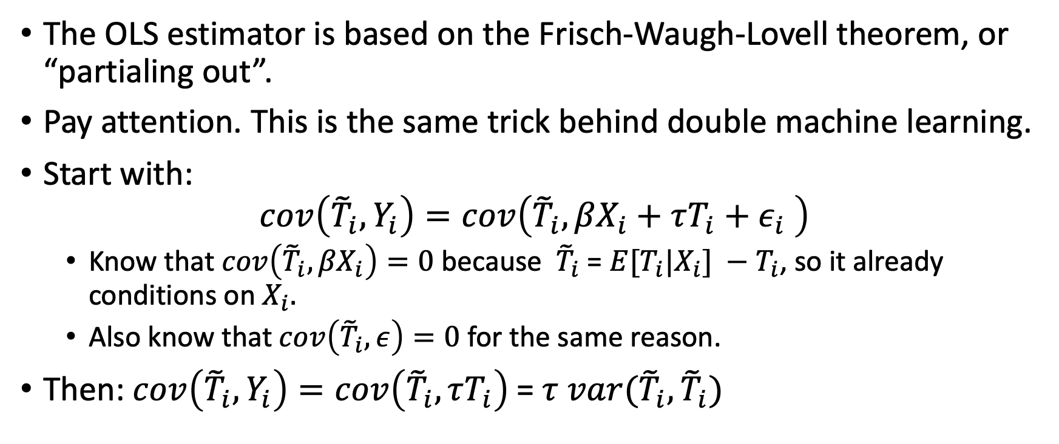
Frisch-Waugh-Lovell Theorem
The OLS estimator is based on the Frisch-Waugh-Lovell theorem, or “partialing out”.
Pay attention. This is the same trick behind double machine learning.
Start with:
$$cov\left({\tilde{T}}_{i}, Y_{i}\right)=cov\left({\tilde{T}}_{i}, {βX}_{i}+τT_{i}+ε_{i} \right)$$
Know that $cov\left({\tilde{T}}_{i}, {βX}_{i}\right)=0$ because ${\tilde{T}}_{i}$ = ${E[T}_{i}|X_{i}] −T_{i}$, so it already conditions on $X_{i}.$
Also know that $cov\left({\tilde{T}}_{i}, ε\right)=0$ for the same reason.
Then: $cov\left({\tilde{T}}_{i}, Y_{i}\right)=cov\left({\tilde{T}}_{i}, τT_{i}\right)$=$τ var({\tilde{T}}_{i}, {\tilde{T}}_{i})$

Slide 31
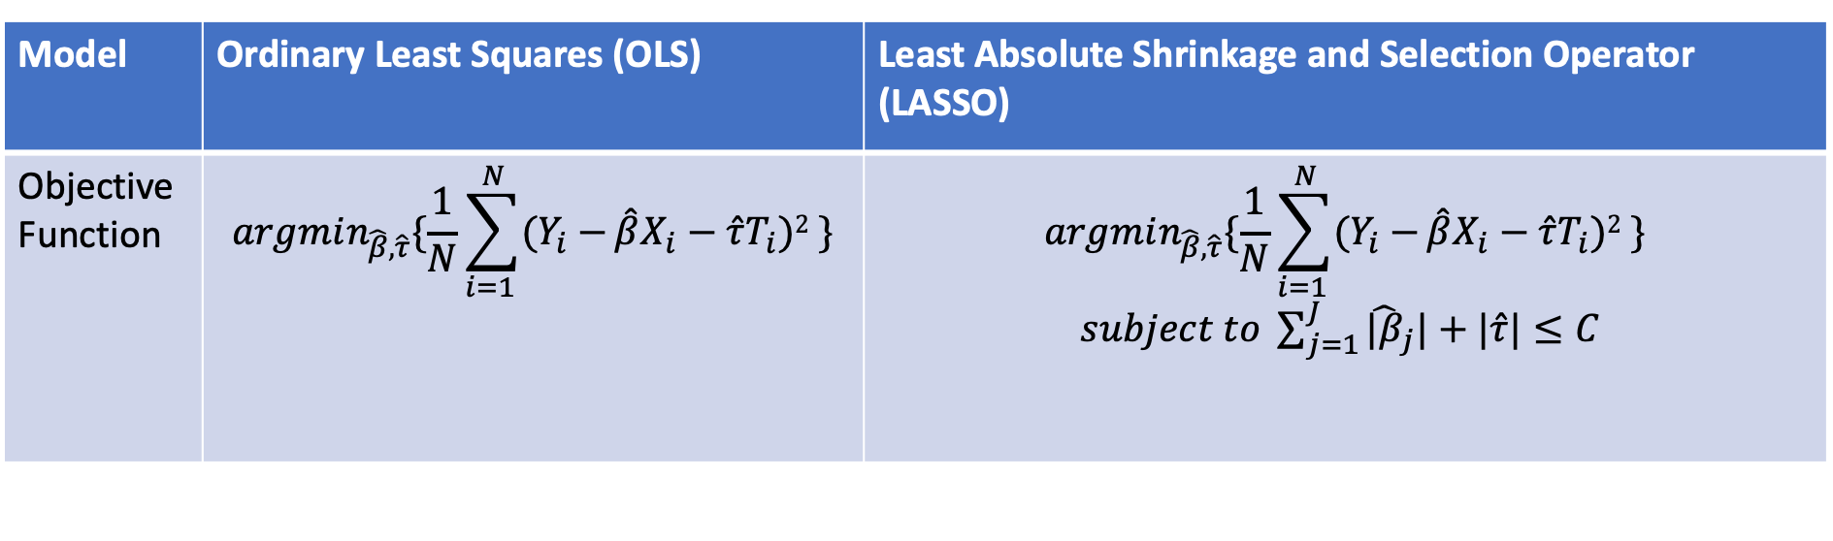
Is LASSO an improvement on OLS?
Model | Ordinary Least Squares (OLS) | Least Absolute Shrinkage and Selection Operator (LASSO)
Objective Function | $$argmin_{\hat{β}, \hat{τ}}\{\frac{1}{N}\sum_{i=1 }^{N}{(Y_{i}−}\hat{β}X_{i}−\hat{τ}T_{i})2 \}$$ | $$argmin_{\hat{β}, \hat{τ}}\{\frac{1}{N}\sum_{i=1 }^{N}{(Y_{i}−}\hat{β}X_{i}−\hat{τ}T_{i})2 \}$$ $subject to \sum_{j=1}^{J}{{\hat{|β}}_{j}|+|\hat{τ}|}≤C$
LASSO regression coefficients are chosen to maximize prediction, subject to a constraint in the parameters.
Intuitively, it assumes that coefficients are zero and there are penalties non-zero coefficients.
Certainly, LASSO has better out-of-sample prediction. But can we use it for causal inference?

Slide 32
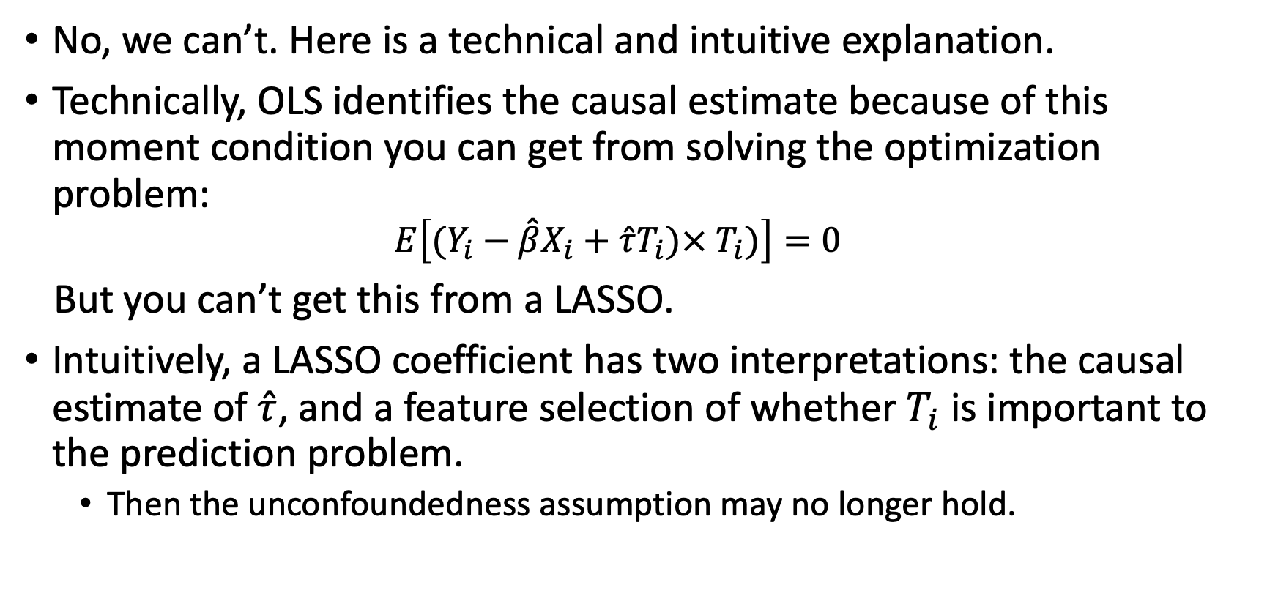
Can we use LASSO for causal inference?
No, we can’t. Here is a technical and intuitive explanation.
Technically, OLS identifies the causal estimate because of this moment condition you can get from solving the optimization problem:
$$E\left[(Y_{i}−\hat{β}X_{i}+\hat{τ}T_{i})×{ T}_{i})\right]=0$$
But you can’t get this from a LASSO.
Intuitively, a LASSO coefficient has two interpretations: the causal estimate of $\hat{τ}$, and a feature selection of whether $T_{i}$ is important to the prediction problem.
Then the unconfoundedness assumption may no longer hold.

Slide 33
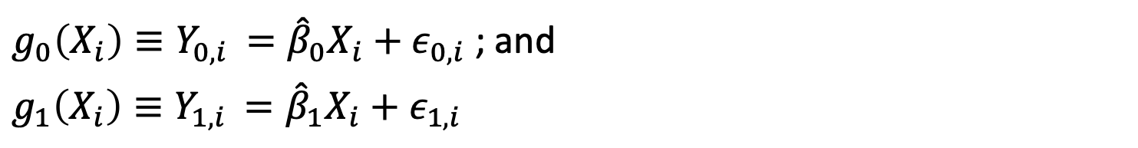
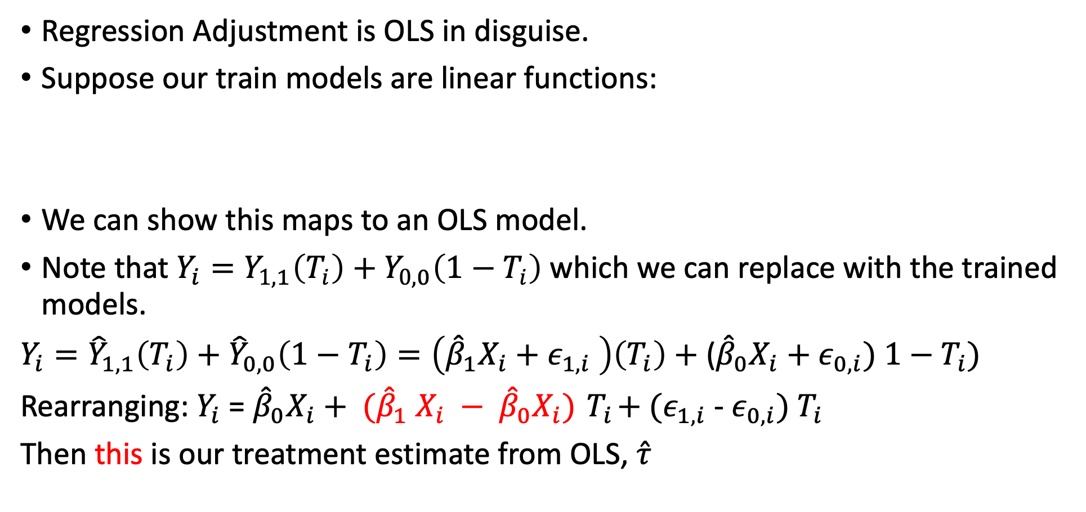
Regression Adjustment is OLS
Regression Adjustment is OLS in disguise.
Suppose our train models are linear functions:
We can show this maps to an OLS model.
Note that $Y_{i}=Y_{1,1}\left(T_{i}\right)+Y_{0,0}\left(1−T_{i}\right)$ which we can replace with the trained models.
$Y_{i}={\hat{Y}}_{1,1}\left(T_{i}\right)+{\hat{Y}}_{0,0}\left(1−T_{i}\right)=\left({\hat{β}}_{1}X_{i}+ε_{1,i} \right)\left(T_{i}\right)+$(${\hat{β}}_{0}X_{i}+ε_{0,i}) 1−T_{i})$
Rearranging: $Y_{i}$ = ${\hat{β}}_{0}X_{i}+ ({\hat{β}}_{1} X_{i} − {\hat{β}}_{0}X_{i}){ T}_{i}+(ε_{1,i}$ - $ε_{0,i}) T_{i}$
Then this is our treatment estimate from OLS, $\hat{τ}$
$g_{0}\left(X_{i}\right)≡Y_{0,i }={\hat{β}}_{0}X_{i}+ε_{0,i}$ ; and
$$g_{1}\left(X_{i}\right)≡Y_{1,i }={\hat{β}}_{1}X_{i}+ε_{1,i}$$

Slide 34
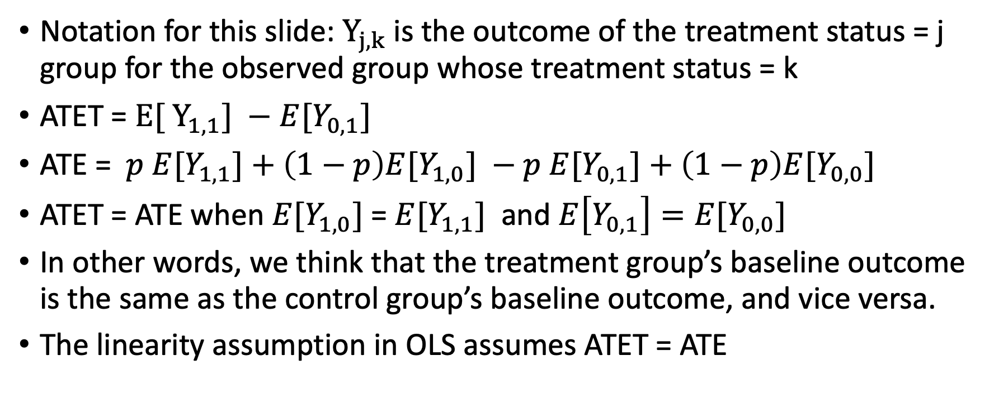
The relationship between ATET/ATE and the linearity assumption
Notation for this slide: $Y_{j,k}$ is the outcome of the treatment status = j group for the observed group whose treatment status = k
ATET = $E[ Y_{1,1}] −$ $E[Y_{0,1}]$
ATE = $p E[Y_{1,1}]+\left(1−p\right)E[Y_{1,0}] −p E[Y_{0,1}]+\left(1−p\right)E[Y_{0,0}]$
ATET = ATE when $E[Y_{1,0}]$= $E[Y_{1,1}]$ and $E\left[Y_{0,1}\right]=E[Y_{0,0}]$
In other words, we think that the treatment group’s baseline outcome is the same as the control group’s baseline outcome, and vice versa.
The linearity assumption in OLS assumes ATET = ATE

Slide 36
Appendix Slides – Doubly Robust Models

Slide 37
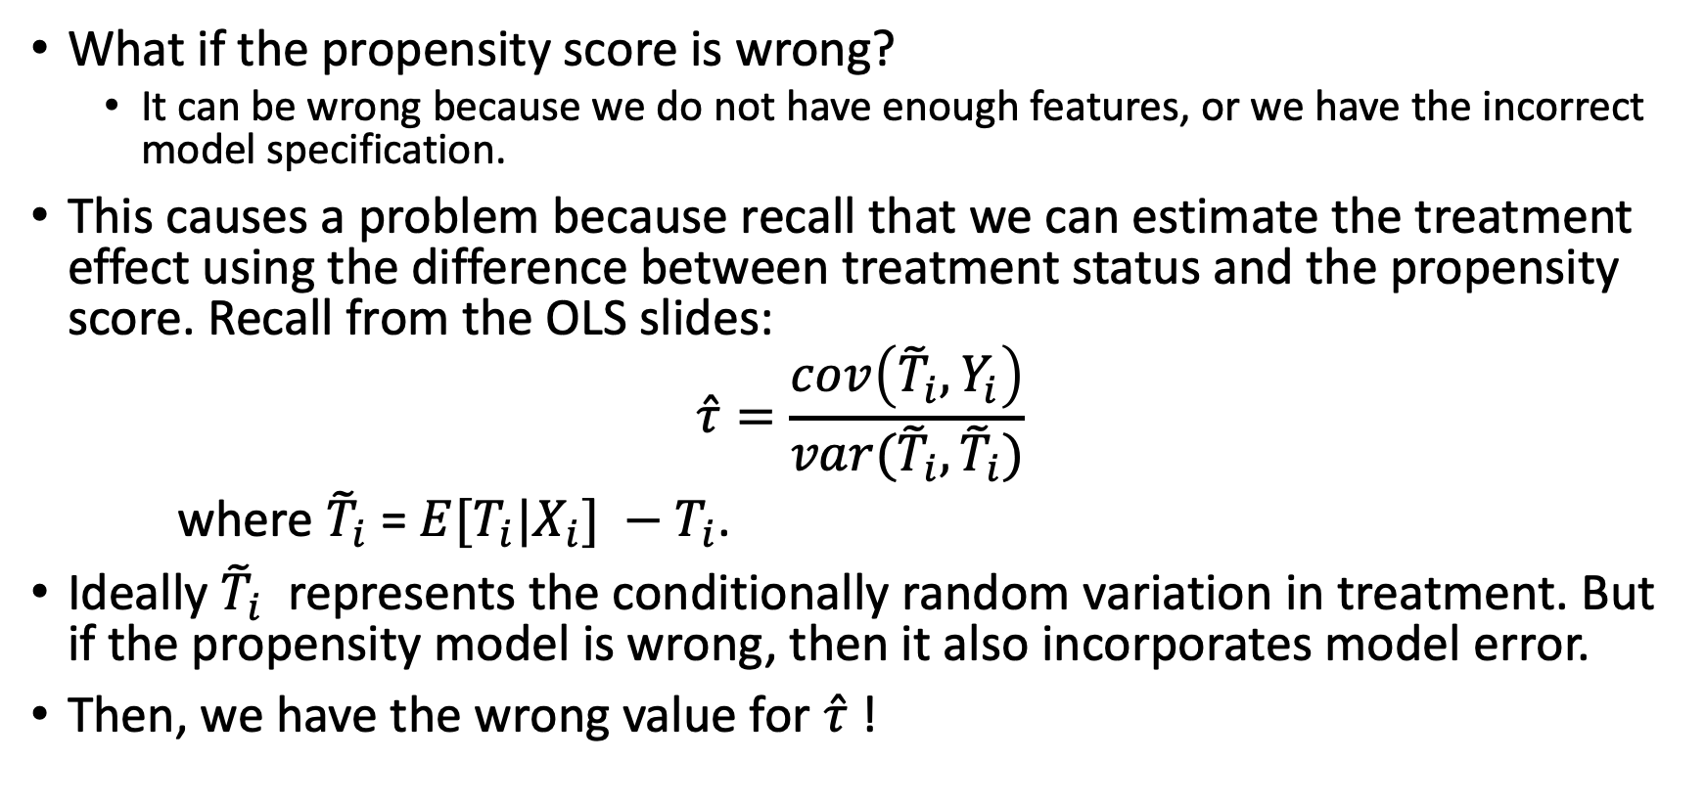
Doubly Robust
What if the propensity score is wrong?
It can be wrong because we do not have enough features, or we have the incorrect model specification.
This causes a problem because recall that we can estimate the treatment effect using the difference between treatment status and the propensity score. Recall from the OLS slides:
$$\hat{τ}=\frac{cov\left({\tilde{T}}_{i}, Y_{i}\right)}{var({\tilde{T}}_{i},{\tilde{T}}_{i})}$$
where ${\tilde{T}}_{i}$ = ${E[T}_{i}|X_{i}] −T_{i}$.
Ideally ${\tilde{T}}_{i}$ represents the conditionally random variation in treatment. But if the propensity model is wrong, then it also incorporates model error.
Then, we have the wrong value for $\hat{τ}$ !

Slide 38
Model mis-specification
The same logic applies to predicting the counterfactual outcome.
Model mis-specification isn’t completely solved with a good ML model.
For example, a counterfactual outcome prediction is an extrapolation exercise.

Slide 39
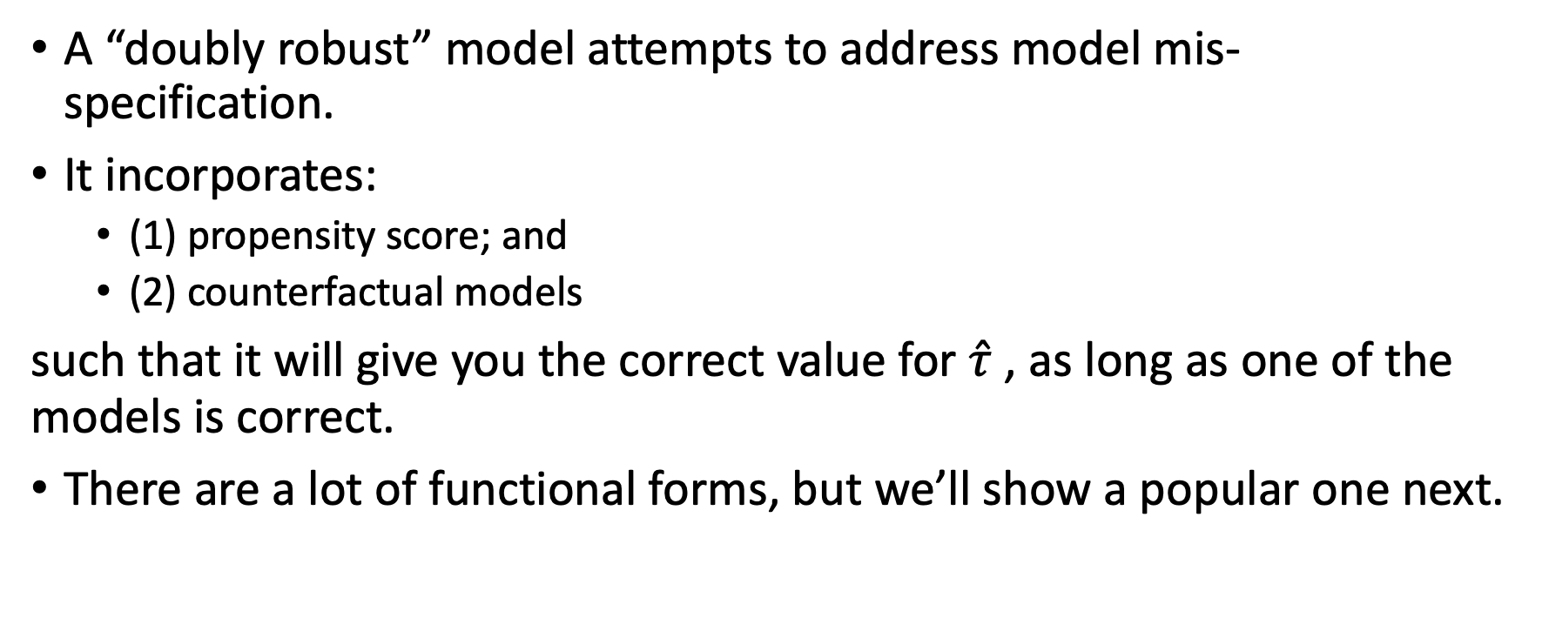
Doubly Robust Mental Model
A “doubly robust” model attempts to address model mis-specification.
It incorporates:
(1) propensity score; and
(2) counterfactual models
such that it will give you the correct value for $\hat{τ}$ , as long as one of the models is correct.
There are a lot of functional forms, but we’ll show a popular one next.

Slide 40
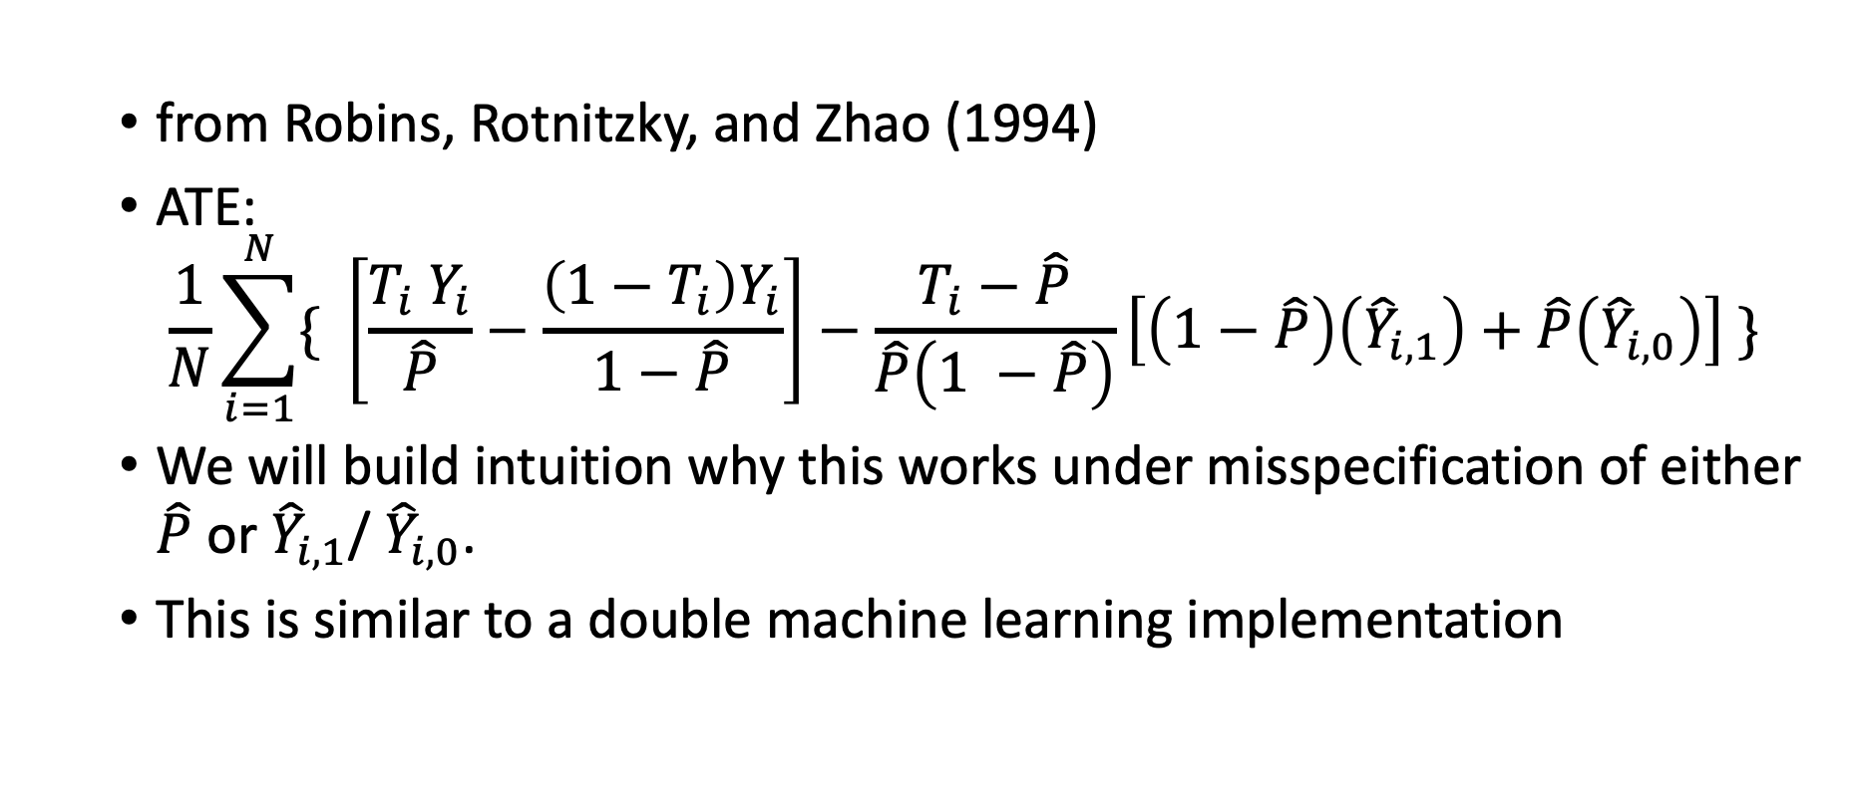
Augmented Inverse Propensity Weight (AIPW) Model Definition
from Robins, Rotnitzky, and Zhao (1994)
ATE:
$$\frac{1}{N}\sum_{i=1}^{N}{\{ \left[\frac{T_{i} Y_{i}}{\hat{P}}−\frac{\left(1−T_{i}\right)Y_{i}}{1−\hat{P}}\right]−\frac{T_{i}−\hat{P}}{\hat{P}\left(1 −\hat{P}\right)}\left[\left(1−\hat{P}\right)\left({\hat{Y}}_{i,1}\right)+\hat{P}\left({\hat{Y}}_{i,0}\right)\right] \}}$$
We will build intuition why this works under misspecification of either $\hat{P}$ or ${\hat{Y}}_{i,1}$/ ${\hat{Y}}_{i,0}$.
This is similar to a double machine learning implementation

Slide 41
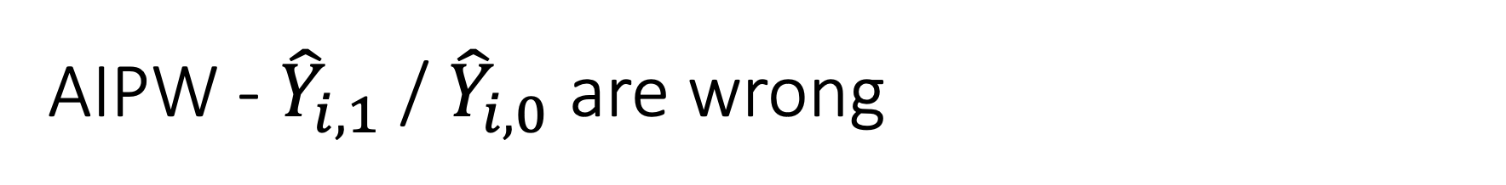
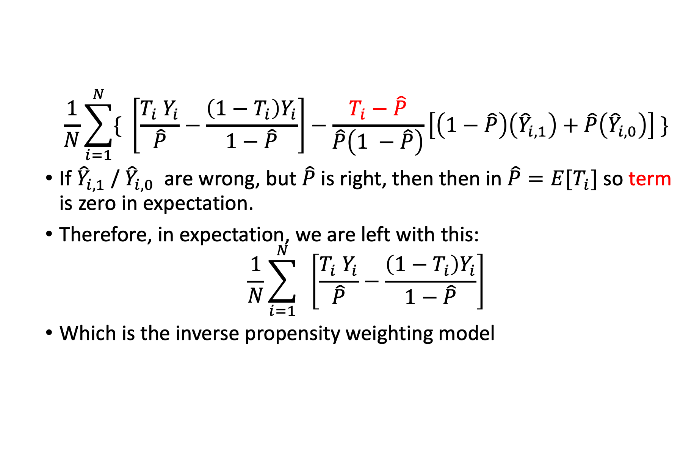
AIPW - ${\hat{Y}}_{i,1}$ / ${\hat{Y}}_{i,0}$ are wrong
$$\frac{1}{N}\sum_{i=1}^{N}{\{ \left[\frac{T_{i} Y_{i}}{\hat{P}}−\frac{\left(1−T_{i}\right)Y_{i}}{1−\hat{P}}\right]−\frac{T_{i}−\hat{P}}{\hat{P}\left(1 −\hat{P}\right)}\left[\left(1−\hat{P}\right)\left({\hat{Y}}_{i,1}\right)+\hat{P}\left({\hat{Y}}_{i,0}\right)\right] \}}$$
If ${\hat{Y}}_{i,1}$ / ${\hat{Y}}_{i,0}$ are wrong, but $\hat{P}$ is right, then then in $\hat{P}=E[T_{i}]$ so term is zero in expectation.
Therefore, in expectation, we are left with this:
$$\frac{1}{N}\sum_{i=1}^{N}{ \left[\frac{T_{i} Y_{i}}{\hat{P}}−\frac{\left(1−T_{i}\right)Y_{i}}{1−\hat{P}}\right]}$$
Which is the inverse propensity weighting model

Slide 42
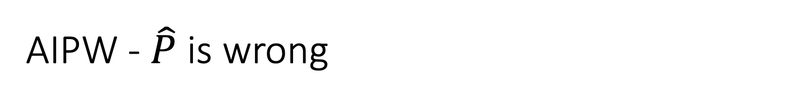
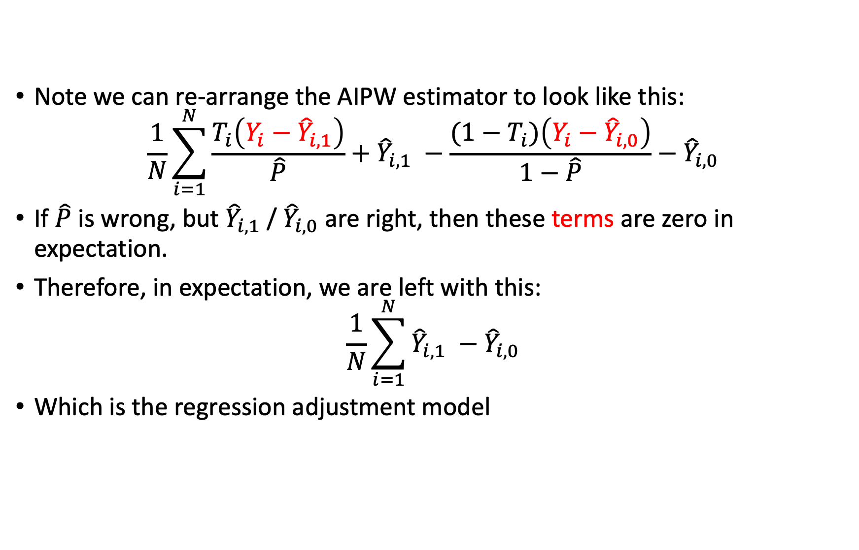
AIPW - $\hat{P}$ is wrong
Note we can re-arrange the AIPW estimator to look like this:
$$\frac{1}{N}\sum_{i=1}^{N}{\frac{T_{i}\left(Y_{i}−{\hat{Y}}_{i,1}\right)}{\hat{P}}+{\hat{Y}}_{i,1} −\frac{{(1−T}_{i})\left(Y_{i}−{\hat{Y}}_{i,0}\right)}{1−\hat{P}}−{\hat{Y}}_{i,0}}$$
If $\hat{P}$ is wrong, but ${\hat{Y}}_{i,1}$ / ${\hat{Y}}_{i,0}$ are right, then these terms are zero in expectation.
Therefore, in expectation, we are left with this:
$$\frac{1}{N}\sum_{i=1}^{N}{{\hat{Y}}_{i,1} −{\hat{Y}}_{i,0}}$$
Which is the regression adjustment model

Slide 43
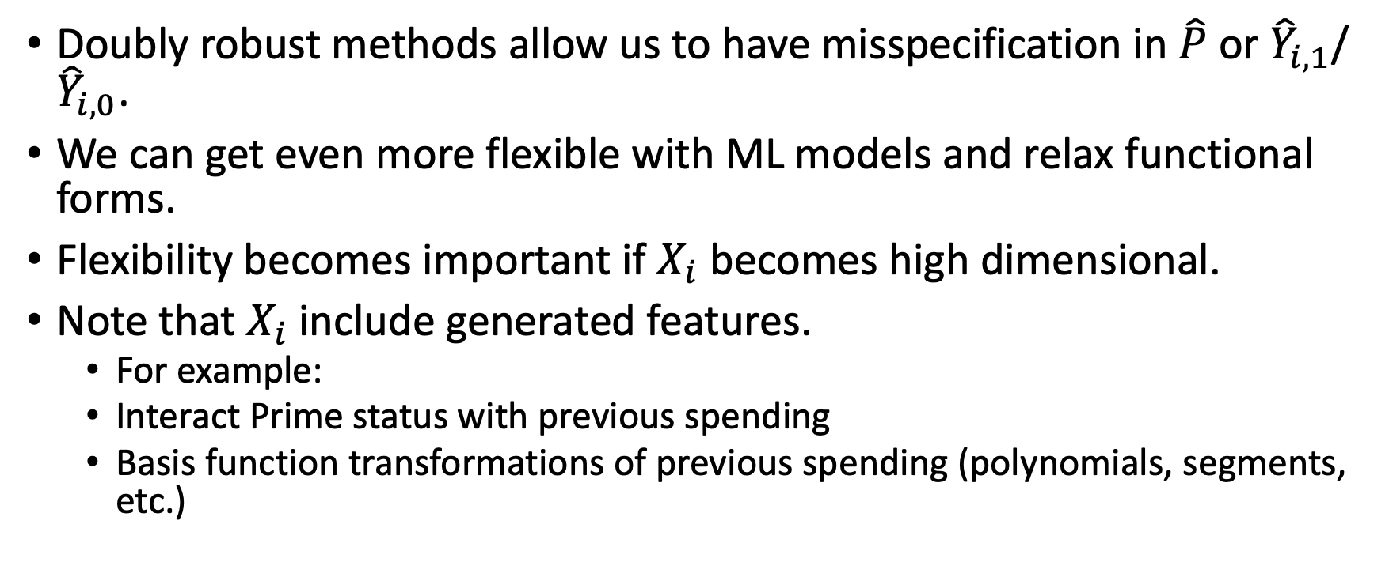
More Misspecification Problems
Doubly robust methods allow us to have misspecification in $\hat{P}$ or ${\hat{Y}}_{i,1}$/ ${\hat{Y}}_{i,0}$.
We can get even more flexible with ML models and relax functional forms.
Flexibility becomes important if $X_{i}$ becomes high dimensional.
Note that $X_{i}$include generated features.
For example:
Interact Prime status with previous spending
Basis function transformations of previous spending (polynomials, segments, etc.)

Slide 44
Appendix Slides – Instrumental Variables

Slide 45
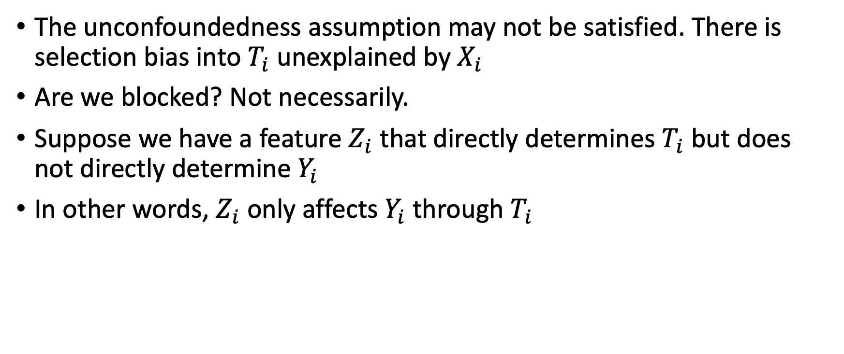
Instrumental Variables (IV) - Motivation
The unconfoundedness assumption may not be satisfied. There is selection bias into $T_{i}$ unexplained by $X_{i}$
Are we blocked? Not necessarily.
Suppose we have a feature $Z_{i}$ that directly determines $T_{i}$ but does not directly determine $Y_{i}$
In other words, $Z_{i}$ only affects $Y_{i}$ through $T_{i}$

Slide 46
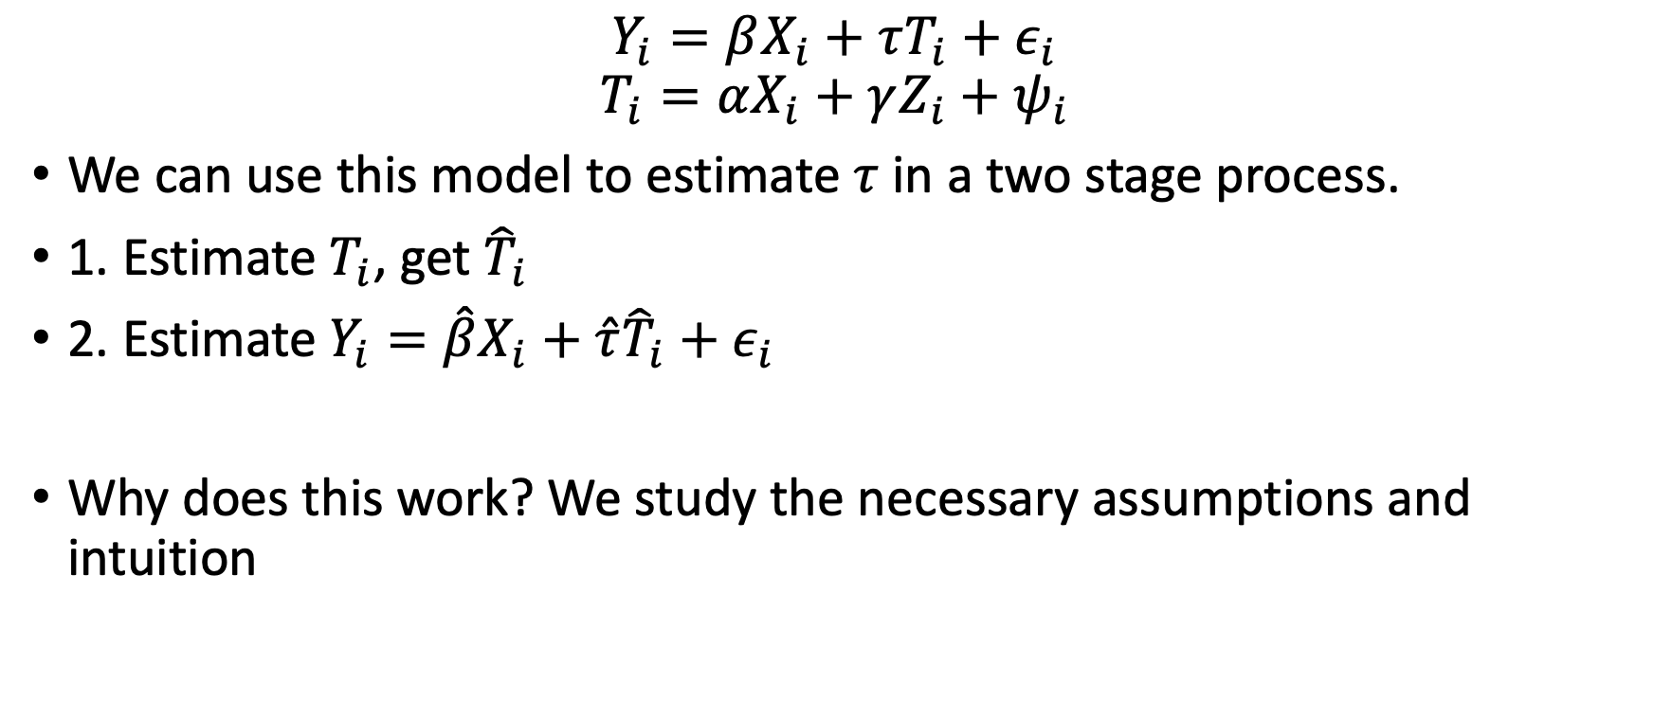
IV Two-Stage Model
$$Y_{i}=βX_{i}+τT_{i}+ε_{i}$$
$$T_{i}=αX_{i}+γZ_{i}+ψ_{i}$$
We can use this model to estimate $τ$ in a two stage process.
1. Estimate $T_{i}$, get ${\hat{T}}_{i}$
2. Estimate $Y_{i}=\hat{β}X_{i}+\hat{τ}{\hat{T}}_{i}+ε_{i}$
Why does this work? We study the necessary assumptions and intuition
Notes:
There are other ways to estimate IV models, such as through maximum likelihood based on the assumptions we will talk about shortly

Slide 47
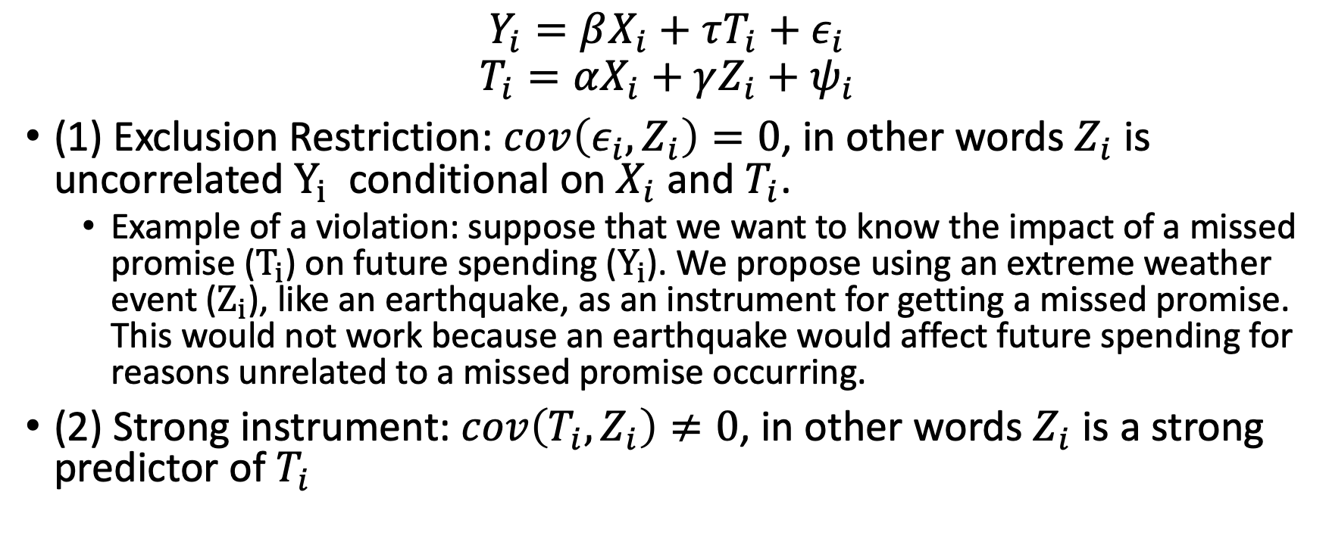
IV Assumptions
$$Y_{i}=βX_{i}+τT_{i}+ε_{i}$$
$$T_{i}=αX_{i}+γZ_{i}+ψ_{i}$$
(1) Exclusion Restriction: $cov\left(ε_{i}, Z_{i}\right)=0$, in other words $Z_{i}$ is uncorrelated $Y_{i}$ conditional on $X_{i}$ and $T_{i}$.
Example of a violation: suppose that we want to know the impact of a missed promise ($T_{i}$) on future spending ($Y_{i}$). We propose using an extreme weather event ($Z_{i}$), like an earthquake, as an instrument for getting a missed promise. This would not work because an earthquake would affect future spending for reasons unrelated to a missed promise occurring.
(2) Strong instrument: $cov\left(T_{i}, Z_{i}\right)≠0$, in other words $Z_{i}$ is a strong predictor of $T_{i}$

Slide 48
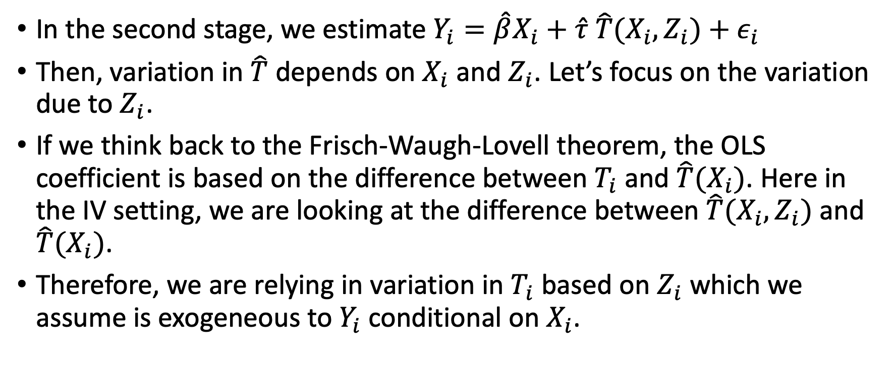
Intuitively, why does this work?
In the second stage, we estimate $Y_{i}=\hat{β}X_{i}+\hat{τ} \hat{T}(X_{i}, Z_{i})+ε_{i}$
Then, variation in $\hat{T}$ depends on $X_{i}$ and $Z_{i}$. Let’s focus on the variation due to $Z_{i}$.
If we think back to the Frisch-Waugh-Lovell theorem, the OLS coefficient is based on the difference between $T_{i}$ and $\hat{T}(X_{i})$. Here in the IV setting, we are looking at the difference between $\hat{T}(X_{i},Z_{i})$ and $\hat{T}(X_{i})$.
Therefore, we are relying in variation in $T_{i}$ based on $Z_{i}$ which we assume is exogeneous to $Y_{i}$ conditional on $X_{i}$.

